Slide 1
Contents
Glossary or Formula Page
Page
Date
Description
2
3

Slide 2
Tasks
24
7
30
Essential Question
Questions
Notes
Summary
4
5

Slide 3
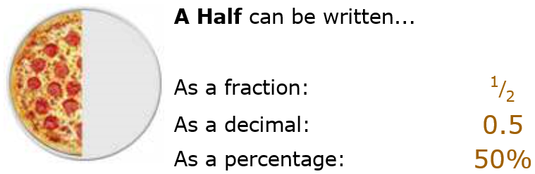
24
7
30
Date
Decimals
EQ – How to connect decimals to fractions and percentages
Decimals, Fractions and Percentages are just different ways of showing the same value:
5

Slide 4
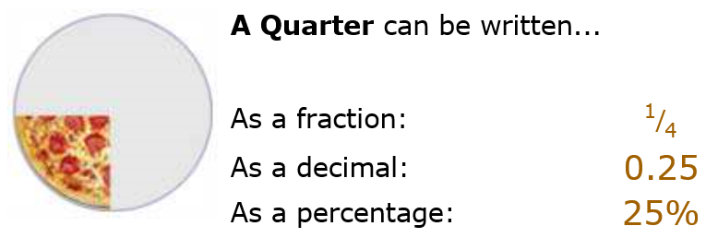
24
7
30
Date
Decimals
EQ – How to connect decimals to fractions and percentages
5

Slide 5
24
7
30
Date
Decimals
EQ – How to connect decimals to fractions and percentages
Converting From a Percent to a Decimal
Step 1: divide by 100, and remove the "%" sign.
The easiest way to divide by 100 is to move the decimal point 2 places to the left:
5

Slide 6
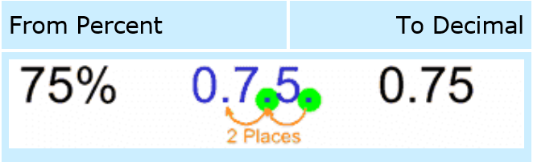

24
7
30
Date
Decimals
EQ – How to connect decimals to fractions and percentages
Converting From a Percent to a Decimal
Step 1: divide by 100, and remove the "%" sign.
The easiest way to divide by 100 is to move the decimal point 2 places to the left:
5

Slide 7
24
7
30
Date
Decimals
EQ – How to connect decimals to fractions and percentages
From Decimal to Percent
Step 1: multiply by 100, and add a "%" sign.
The easiest way to multiply by 100 is to move the decimal point 2 places to the right:
5

Slide 8
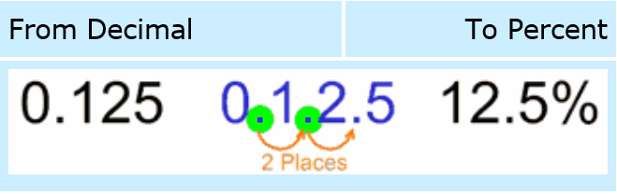

24
7
30
Date
Decimals
EQ – How to connect decimals to fractions and percentages
From Decimal to Percent
Step 1: multiply by 100, and add a "%" sign.
The easiest way to multiply by 100 is to move the decimal point 2 places to the right:
5

Slide 9
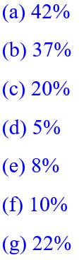
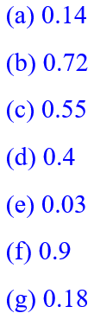
Questions
Write these percentages as decimals:
Write these decimals as percentages:

Slide 10
24
7
30
Date
Decimals
EQ – How to connect decimals to fractions and percentages
From Fraction to Decimal
Step 1: Divide the top number by the bottom number (divide the numerator by the denominator in mathematical language)
5

Slide 11
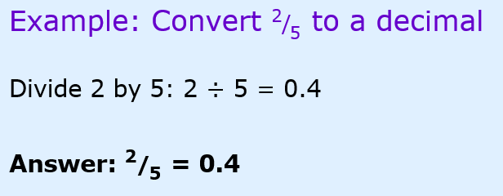
24
7
30
Date
Decimals
EQ – How to connect decimals to fractions and percentages
From Fraction to Decimal
Step 1: Divide the top number by the bottom number (divide the numerator by the denominator in mathematical language)
5

Slide 12
24
7
30
Date
Decimals
EQ – How to connect decimals to fractions and percentages
From Decimal to Fraction
To convert a decimal to a fraction needs a little more work.
5

Slide 13
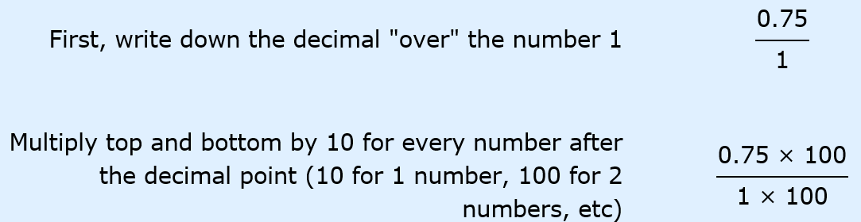
24
7
30
Date
Decimals
EQ – How to connect decimals to fractions and percentages
Example: To convert 0.75 to a fraction
5

Slide 14
24
7
30
Date
Decimals
EQ – How to connect decimals to fractions and percentages
Example: To convert 0.75 to a fraction
5

Slide 15
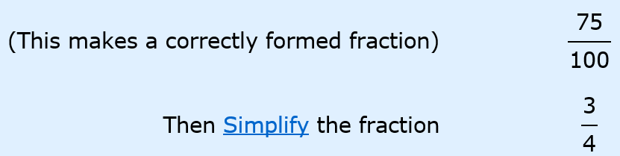
24
7
30
Date
Decimals
EQ – How to connect decimals to fractions and percentages
5

Slide 16


Questions
Write these percentages as fractions in their simplest form:
Write these fractions as percentages:

Slide 17
Notes Review
24, 7 ,30
Date
Title
Essential question
Notes complete
Notes complete with colour and diagrams
Questions completed
Contents page filed in
Formula page filled in

Slide 18
Homework
Review your notes and write a summary answering the essential question.

